Slide 1


R.M.D. Engineering College
22CS202
JAVA PROGRAMMING
UNIT III
MULTITHREADING, I/O AND GENERIC PROGRAMMING

Slide 2
SYLLABUS
Multithreaded Programming: Creating a Thread, Thread Priorities, Synchronization, Interthread Communication
I/O: I/O Basics, Reading Console Input, Writing Console Output, Reading and Writing Files
Generics: Introduction, Generic class, Bounded Types, Generic Methods, Generic Interfaces, Generic Restrictions.

Slide 3
THREAD
Thread
A thread is referred as a light weight smallest part of a process.
Threads are independent because all the threads follow a separate path of execution within the program.
Each thread has its own program counter, stack and local variables.
It uses a shared memory area, files and per-process state.

Slide 4
Multithreading
The process of executing multiple threads simultaneously is known as multithreading.
Multithreading is a programming concept where a program (process) is divided into two or more subprograms (process), which can be implemented at the same time in parallel.
A multithreaded program contains two or more parts that can run concurrently and each part can perform different task at the same time making optimal use of the available resources.
Each part of such a program is called a thread, and each thread defines a separate path of execution.

Slide 5
Advantages of Java Multithreading
It doesn't block the user because threads are independent and multiple operations can be performed at the same time.
It can perform many operations together, hence saves time.
Threads are independent, so it doesn't affect other threads if an exception occurs in one thread.

Slide 6
Multitasking
Multitasking is a process of executing multiple tasks simultaneously. Multitasking is when multiple processes share common processing resources such as a CPU.
Multitasking can be achieved in two ways:
Process-based Multitasking (Multiprocessing)
Thread-based Multitasking (Multithreading)

Slide 7
Process-based multi-tasking (Multiprocessing)
Executing various jobs or process together where each process is a separate independent operation is called process-based multi-tasking.
Each process has a separate address in memory and switching from one process to another requires some time for saving and loading registers and updating lists.
A process is heavy weight and cost of communication between the process is high.

Slide 8
Thread-based multi-tasking (Multithreading)
Executing several tasks simultaneously where each task is a separate independent part of the same program is called Thread-based multitasking and each independent part is called Thread.
The main goal of multi-tasking is to make or do a better performance of the system by reducing response time.
Threads share the same address space. A thread is light weight and cost of communication between the thread is low.

Slide 9
Different between Multitasking and Multithreading
FEATURES | MULTITASKING | MULTITHREADING
Definition | When a single processor does many jobs (program, threads, process, task) at the same time, it is referred to as multitasking. | Multitasking occurs when the CPU does many tasks, such as a program, process, task, or thread.
Basic | A CPU may perform multiple tasks at once by using the multitasking method. | Multithreading allows a CPU to generate numerous threads from a job and process them all at the same time.
Resources and Memory | The system must assign different resources and memory to separate programs that are running concurrently in multitasking. | The system assigns a single memory block to each process.
Switching | CPU switches between programs frequently. | CPU switches between the threads frequently.
Speed of Execution | It is comparatively slower in execution. | It is comparatively faster in execution.
Working | A user may easily run several jobs off of their CPU at once. | A CPU has the ability to split a single program into several threads to improve its functionality and efficiency.
Process Termination | The process of terminating a task takes comparatively more time. | It requires considerably less time to end a process.

Slide 10
LIFE CYCLE OF A THREAD
A thread can be in any of the following states:
New
Runnable
Running
Blocked
Waiting
Timed Waiting
Terminated

Slide 11
Explanation
New: A newly created thread that has not yet started the execution. It remains in this state until the program starts the thread using start() method.
It is also referred to as a born thread.
Runnable: If a thread is in this state it means that the thread is ready for execution and waiting for the availability of the processor.
If all threads in queue are of same priority then they are given time slots for execution in round robin fashion.

Slide 12
Running: It means that the processor has given its time to the thread for execution. A thread keeps running until the following conditions occurs:
Thread give up its control on its own and it can happen in the following situations:
A thread gets suspended using suspend() method which can only be revived using resume() method.
A thread is made to sleep for a specified period of time using sleep(time) method, where time is specified in milliseconds.
A thread is made to wait for some event to occur using wait() method. In this case a thread can be scheduled to run again using notify() method.
A thread is pre-empted by a higher priority thread.

Slide 13
Blocked: If a thread is prevented from entering into runnable state or waiting for I/O to complete, then a thread is said to be in Blocked state. A thread in this state cannot continue its execution until it is moved to runnable state.
Any thread in these states does not consume any CPU cycle.
Waiting: A thread waits indefinitely for another thread to perform a task. A thread transitions back to the runnable state only when another thread signals the waiting thread to continue executing.
Timed Waiting: A thread that is waiting for another thread to perform a task for a specified interval of time. A thread in this state transitions back to the runnable state when that time interval expires or when the event it is waiting for occurs.
Terminated: A runnable thread enters the dead or terminated state when it successfully completes its task or otherwise terminated due to any error or even forcefully killed.

Slide 14
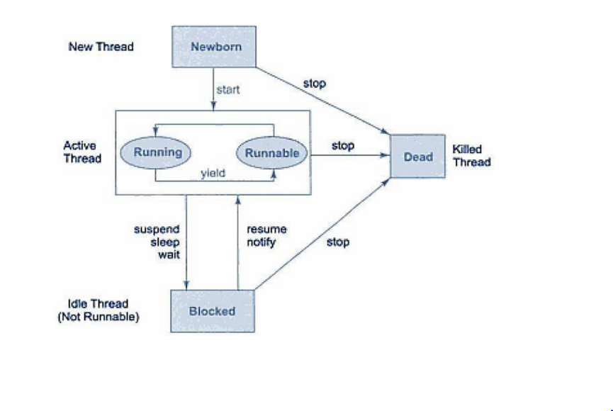
THREAD-LIFE CYCLE

Slide 15
The Main() thread
When we run any java program, the program begins to execute its code starting from the main method.
Therefore, the JVM creates a thread to start executing the code present in main method. This thread is called as main thread.
Although the main thread is automatically created, it can be controlled by obtaining a reference to it by calling currentThread() method.
Two important things to know about main thread are,
It is the thread from which other threads will be produced.
main thread must be always the last thread to finish execution.

Slide 16
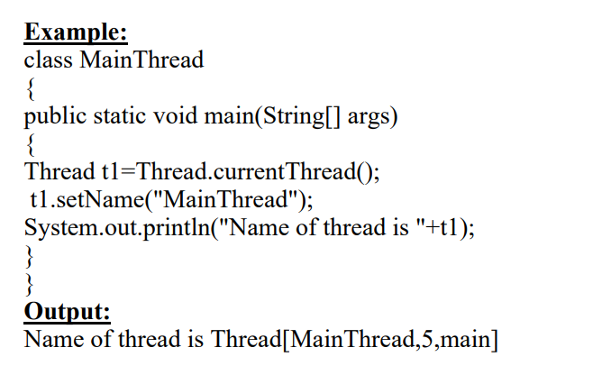

Slide 17
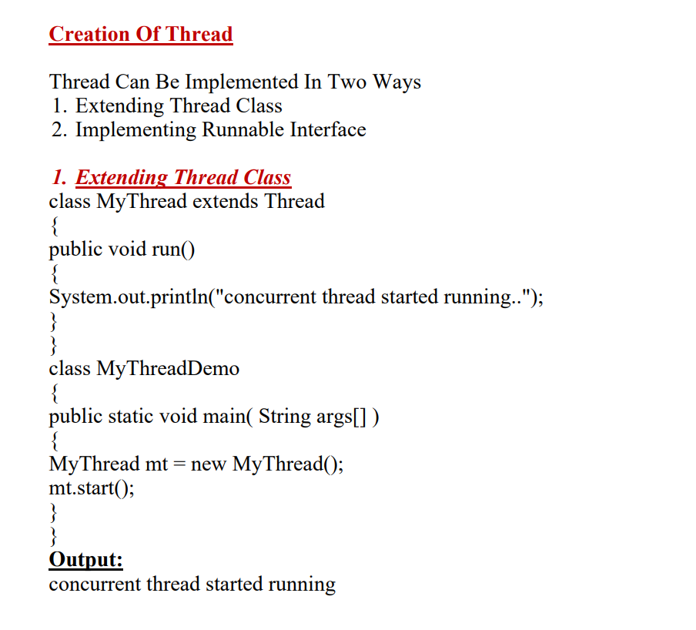
CREATION OF THREAD

Slide 18
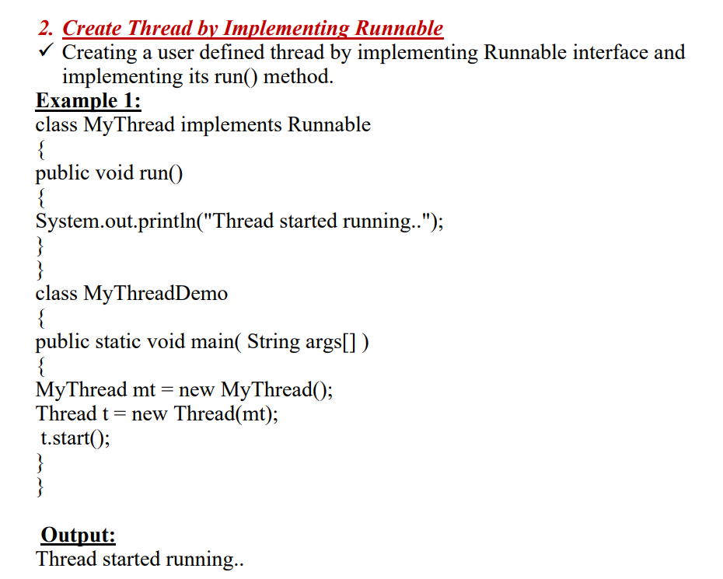

Slide 19
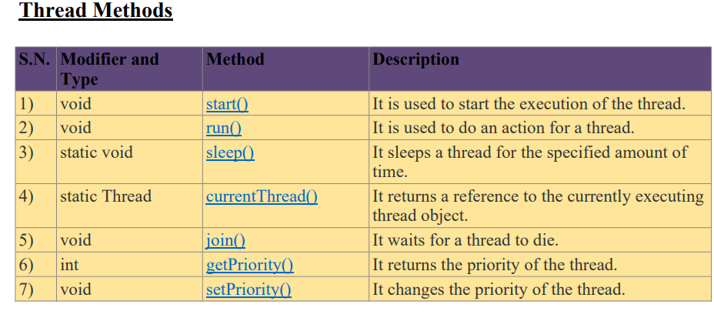

Slide 20
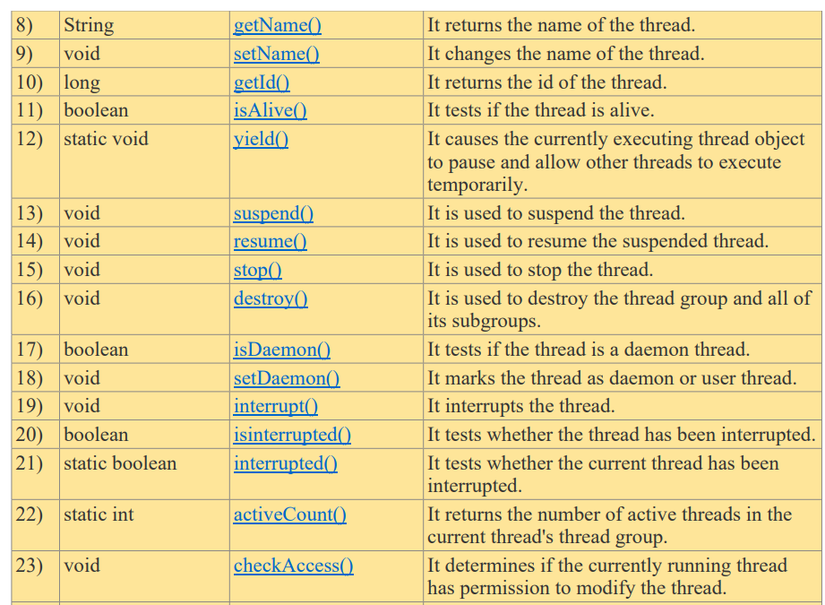

Slide 21
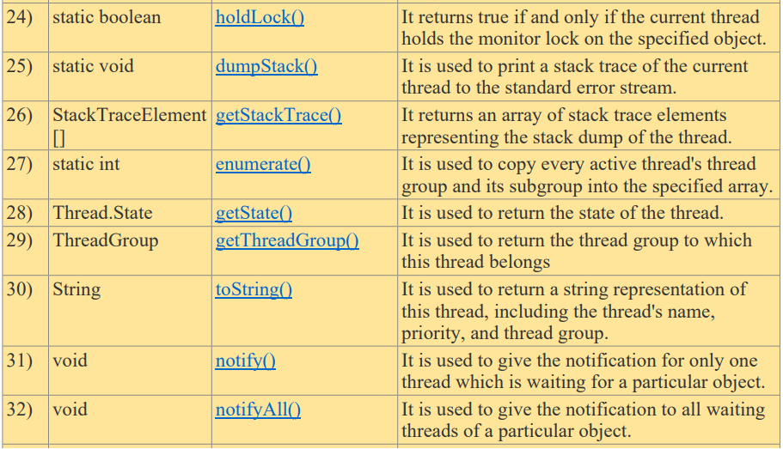

Slide 22
THREAD PRIORITIES
Min:1
Default:5
Max:10
Thread priorities are integers which decide how one thread should be treated with respect to the others.
Thread priority decides when to switch from one running thread to another, and the process is called context switching.
A thread can voluntarily release control and the highest priority thread that is ready to run is given the CPU.
A thread can be preempted by a higher priority thread no matter what the lower priority thread is doing. Whenever a higher priority thread wants to run it does.
To set the priority of the thread, setPriority() method is used which is a method of the Thread Class.
In place of defining the priority in integers, we can use MIN_PRIORITY with value 1, NORM_PRIORITY(Default Priority) with value 5, MAX_PRIORITY with value 10

Slide 23
Get and Set Thread Priority
int getPriority(): Thread.getPriority() method returns priority of given thread.
void setPriority(int newPriority): Thread.setPriority() method changes the priority of thread to the value new Priority.
This method throws IllegalArgumentException if value of parameter new Priority goes beyond minimum(1) and maximum(10) limit.

Slide 24
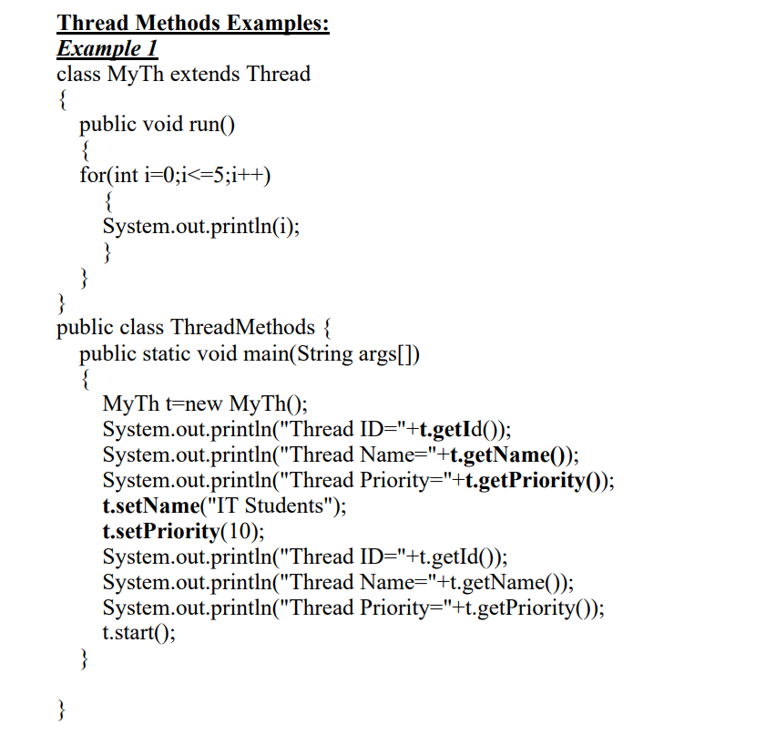
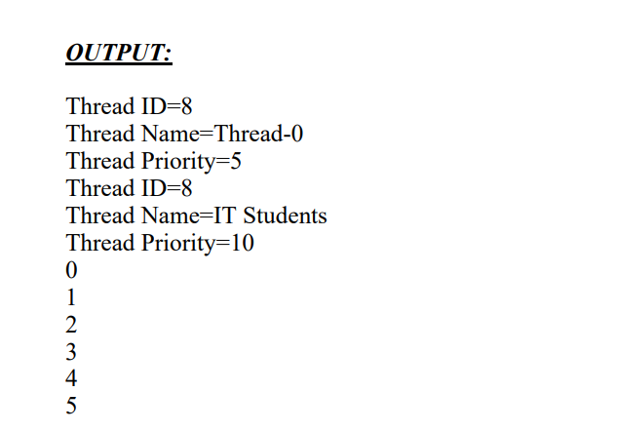

Slide 25
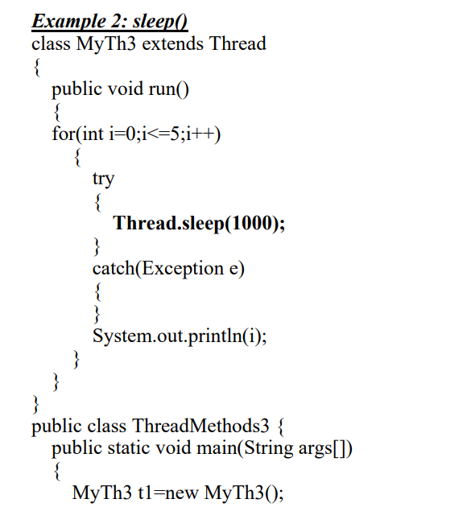
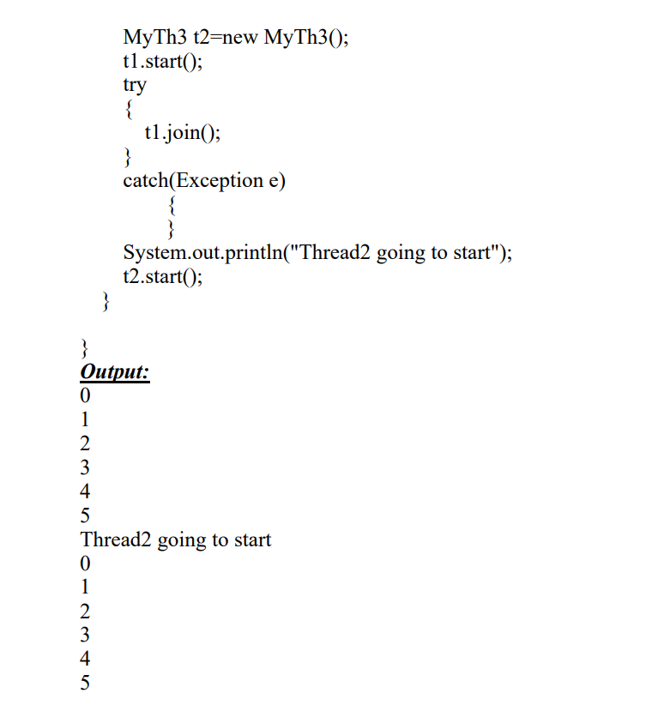

Slide 26
Thread Synchronization
There are two types of thread synchronization namely mutual exclusive and inter- thread communication.
Mutual Exclusive
Synchronized method.
Synchronized block.
Static synchronization.
Cooperation (Inter-thread communication in java)

Slide 27
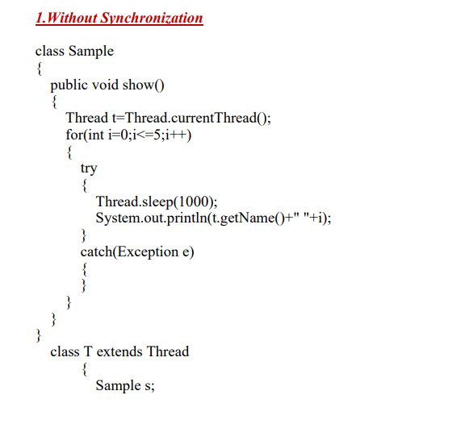
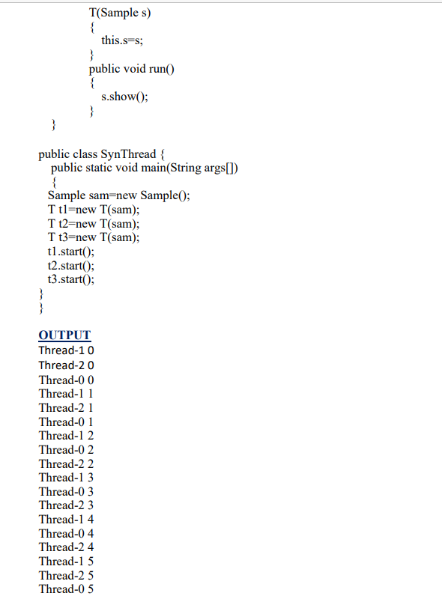

Slide 28
1. Mutual Exclusive helps keeping threads from interfering with one another while sharing data. This can be done by three ways in java:
by synchronized method
by synchronized block
by static synchronization
Synchronized method:
If you declare any method as synchronized, it is known as synchronized method. Synchronized method is used to lock an object for any shared resource.
When a thread invokes a synchronized method, it automatically acquires the lock for that object and releases it when the thread completes its task.

Slide 29
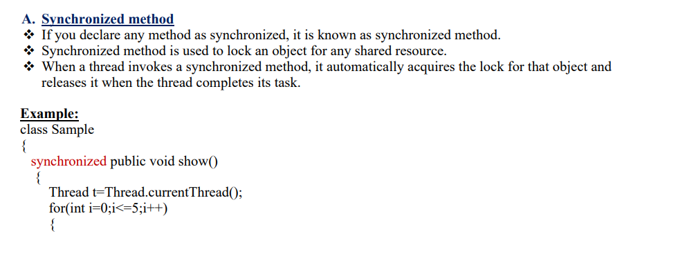

Slide 30
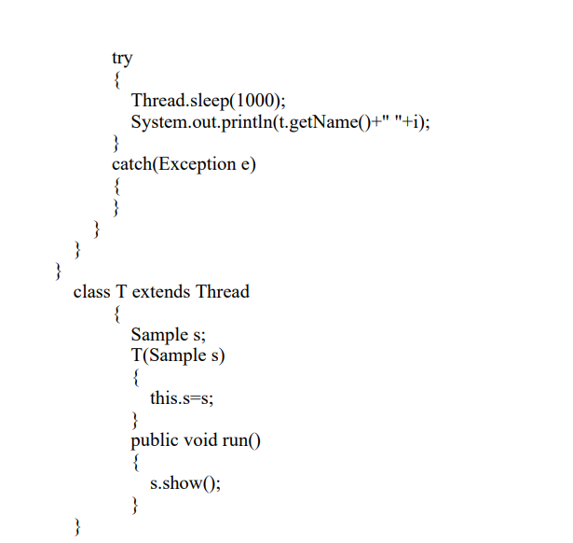
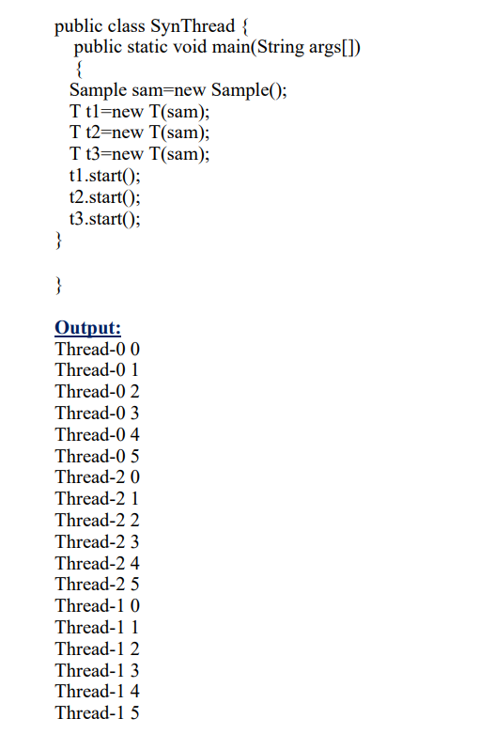

Slide 31
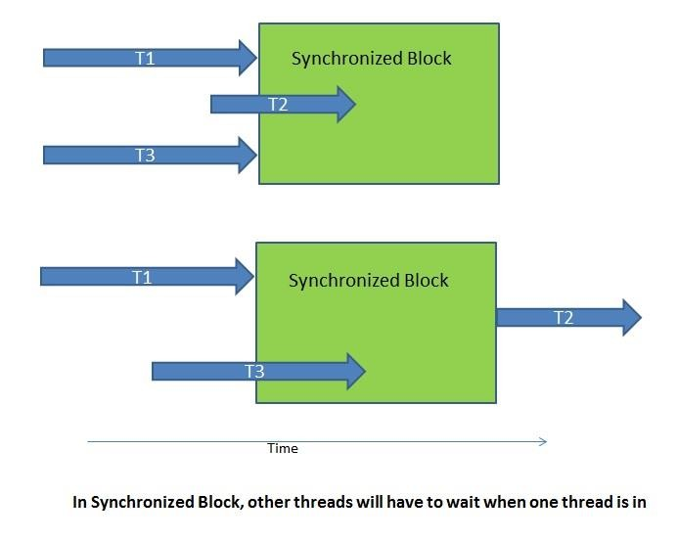
Synchronized Block
Syntax for synchronized block
synchronized (object reference expression)
{
//code block
}

Slide 32
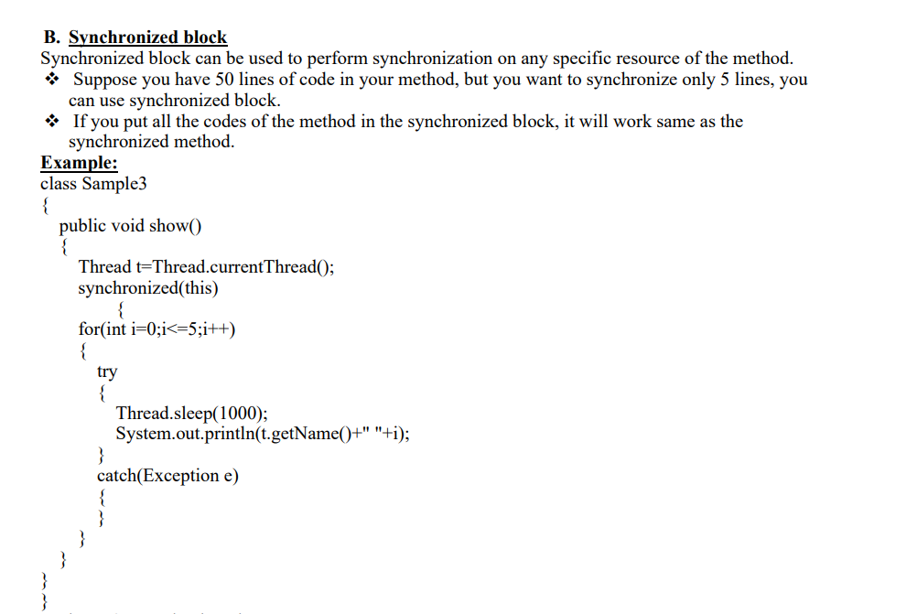

Slide 33
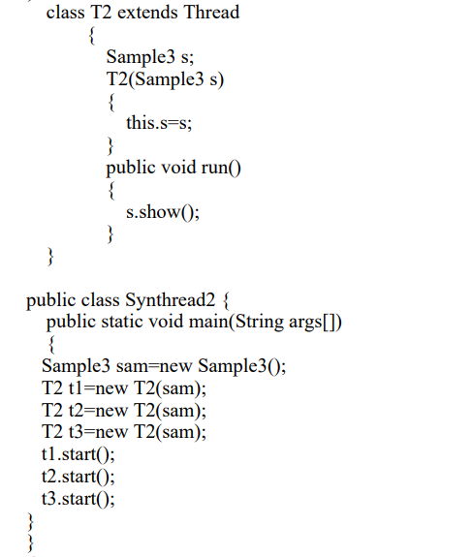

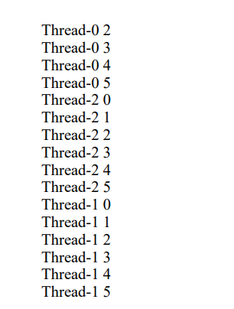

Slide 34
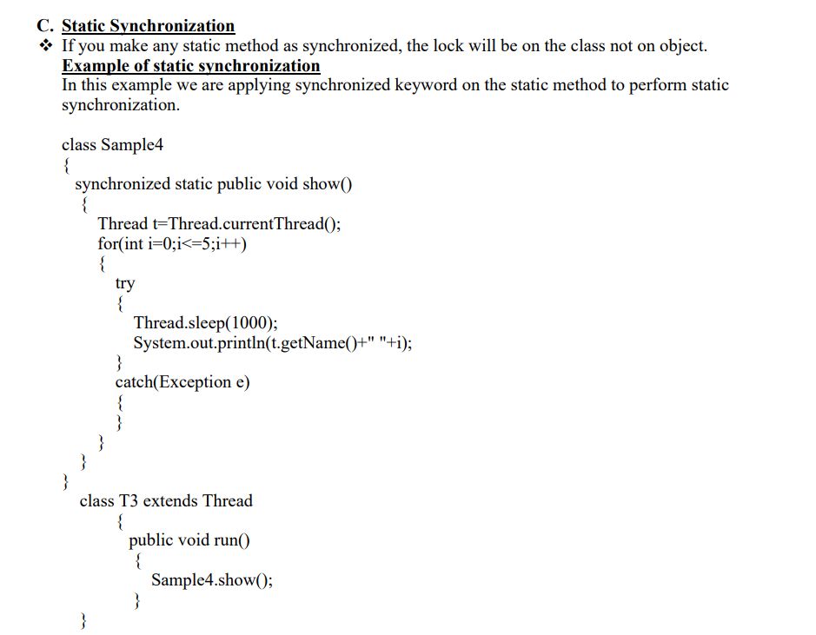
STATIC SYNCHRONIZATION

Slide 35
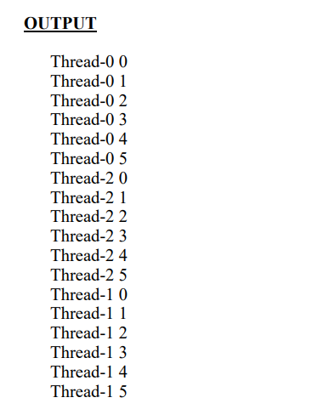
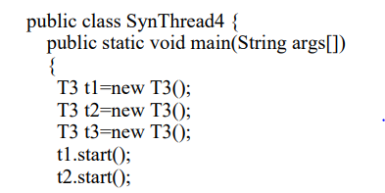
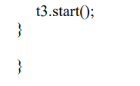

Slide 36
INTER-THREAD COMMUNICATION
Definition
Inter-Thread communication or Co-operation is defined as the process of allowing synchronized threads to communicate with each other.
It is a mechanism in which a thread is paused running in its critical section and another thread is allowed to enter (or lock) in the same critical section to be executed.

Slide 37
Methods of Object class used to implement Inter-Thread Communication
Inter-Thread Communication can be implemented by following methods of Object class
wait()
notify()
notifyAll()

Slide 38


wait() Method causes current thread to release the lock and wait until either another thread invokes the notify() method or the notifyAll() method for this object, or a specified amount of time has elapsed.
Syntax:
public final void wait()throws InterruptedException
public final void wait(long timeout)throws InterruptedException

Slide 39

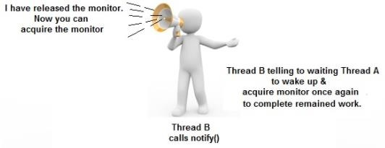
notify() method wakes up a single thread that is waiting on this object's monitor. If any threads are waiting on this object, one of them is chosen to be awakened.
Syntax: public final void notify()
notifyAll() wakes up all the threads that called wait() on the same object.
Syntax: public void notifyAll()

Slide 40
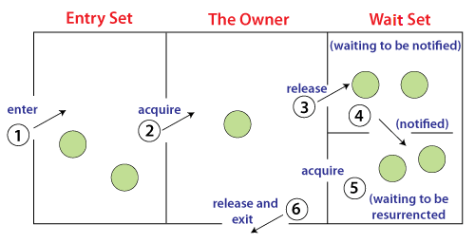
Understanding the process of inter-thread communication
The point to point explanation of the above diagram is as follows:
Threads enter to acquire lock.
Lock is acquired by on thread.
Now thread goes to waiting state if you call wait() method on the object. Otherwise it releases the lock and exits.
If you call notify() or notifyAll() method, thread moves to the notified state (runnable state).
Now thread is available to acquire lock.
After completion of the task, thread releases the lock and exits the monitor state of the object.

Slide 41
Difference between wait and sleep?
wait() | sleep()
The wait() method releases the lock. | The sleep() method doesn't release the lock.
It is a method of Object class | It is a method of Thread class
It is the non-static method | It is the static method
It should be notified by notify() or notifyAll() methods | After the specified amount of time, sleep is completed.

Slide 42
Example for Inter-Thread Communication (Producer Consumer Problem)
Producer-consumer problem (also known as the bounded-buffer problem) is a classic example of a multi-process synchronization problem.
The problem describes two processes, the producer and the consumer, which share a common, fixed-size buffer used as a queue.

Slide 43

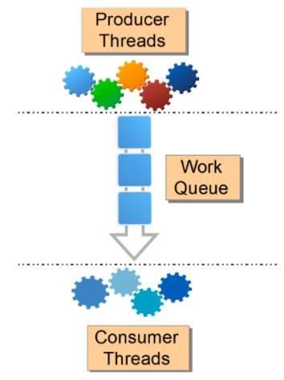
The producer’s job is to generate data, put it into the buffer, and start again
At the same time, the consumer is consuming the data (i.e. removing it from the buffer), one piece at a time.
While implementing, the following two conditions should be satisfied:
Producer should not try to add data into the buffer when it is full
Consumer should not try to remove data from an empty buffer

Slide 44
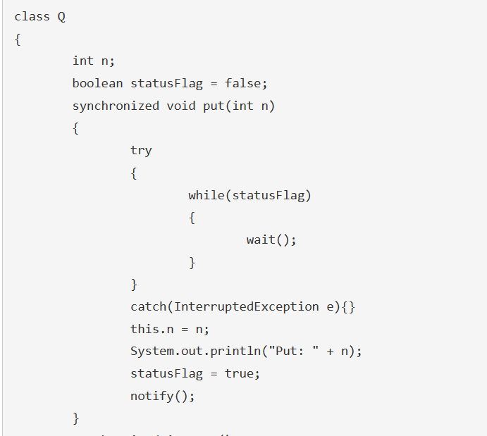
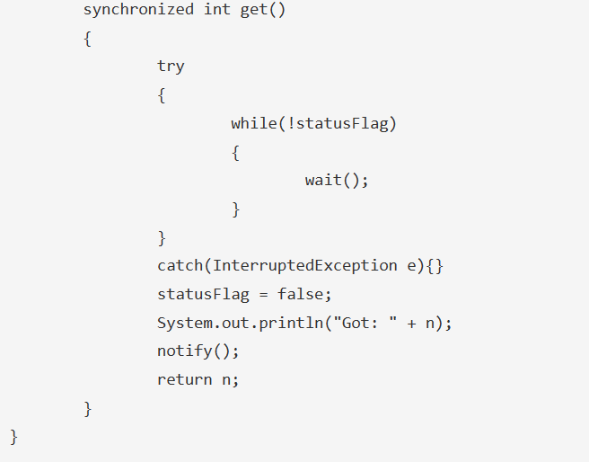
PROGRAM FOR PRODUCER CONSUMER PROBLEM IMPLEMENTATION

Slide 45
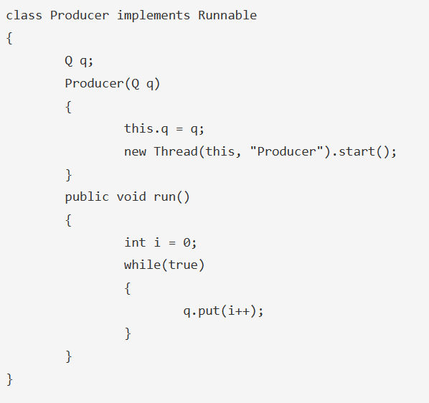
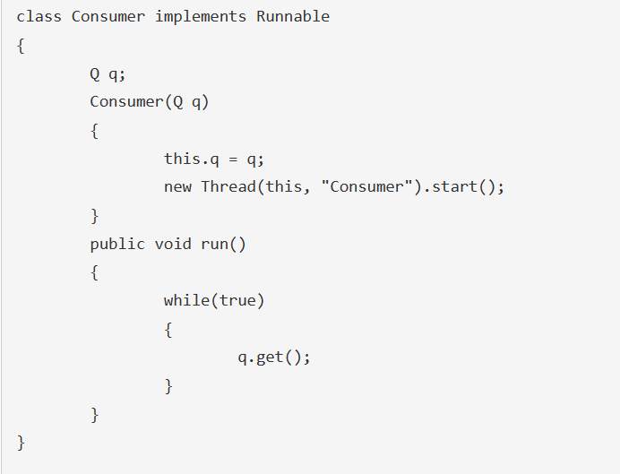

Slide 46
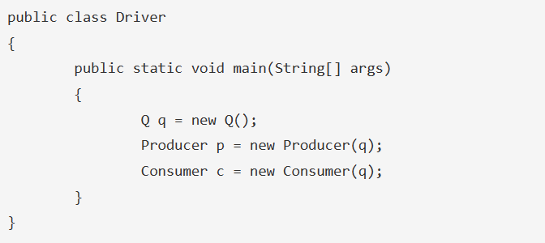
OUTPUT
Put: 1
Got: 1
Put: 2
Got: 2
Put: 3
Got: 3
…

Slide 47
INPUT/ OUTPUT BASICS
Java I/O (Input and Output) is used to process the input and produce the output.
Java uses the concept of a stream to make I/O operation fast.
The java.io package contains all the classes required for input and output operations.
Stream
A stream can be defined as a sequence of data.
There are two kinds of Streams
InputStream − The InputStream is used to read data from a source.
OutputStream − The OutputStream is used for writing data to a destination.

Slide 48
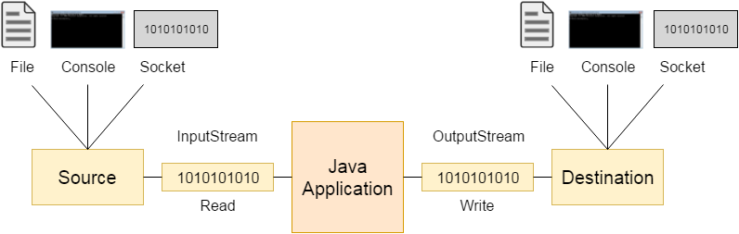

Slide 49
Byte Streams
Java byte streams are used to perform input and output of 8-bit bytes. Though there are many classes related to byte streams but the most frequently used classes are,
FileInputStream
FileOutputStream.

Slide 50
Following is an example which makes use of these two classes to copy an input file into an output file
import java.io.*;
public class CopyFile {
public static void main(String args[]) throws IOException {
FileInputStream in = null; FileOutputStream out = null; try {
in = new FileInputStream("input.txt");
out = new FileOutputStream("output.txt");
int c;
while ((c = in.read()) != -1) {
out.write(c);
}
}finally {
if (in != null) {
in.close();
}
if (out != null) {
out.close();
}
}
}
}
Now let's have a file input.txt with the following content −
This is test for copy file.
As a next step, compile the above program and execute it, which will result in
creating output.txt file with the same content as we have in input.txt. So let's put
the above code in CopyFile.java file and do the following
$javac CopyFile.java
$java CopyFile

Slide 51
Character Streams
Java Byte streams are used to perform input and output of 8-bit bytes, whereas Java Character streams are used to perform input and output for 16-bit unicode.
Though there are many classes related to character streams but the most frequently used classes are, FileReader and FileWriter. Though internally FileReader uses FileInputStream and FileWriter uses FileOutputStream but here the major difference is that FileReader reads two bytes at a time and FileWriter writes two bytes at a time.

Slide 52
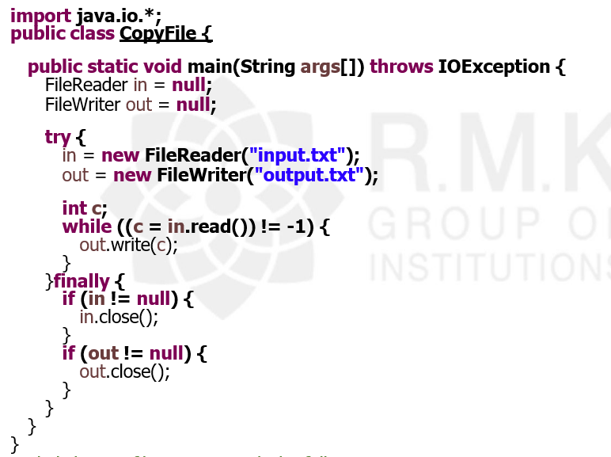
EXAMPLE
Now let's have a file input.txt with the following content .
This is test for copy file.
As a next step, compile the above program and execute it, which will result in creating output.txt file with the same content as we have in input.txt. So let's put the above code in CopyFile.java file and do the following
$javac CopyFile.java
$java CopyFile

Slide 53
Standard Streams
All the programming languages provide support for standard I/O where the user's program can take input from a keyboard and then produce an output on the computer screen.
In Java, 3 streams are created for us automatically with the console.
System.out: standard output stream
System.in: standard input stream
System.err: standard error stream

Slide 54
Example
System.out.println("simple message");
int i=System.in.read();//returns ASCII code of 1st character System.out.println((char)i);//will print the character
System.err.println("error message");

Slide 55
Reading and Writing Console
Reading Console Input:
The preferred method of reading console input is to use a character-oriented stream.
There are three different ways for reading input from the user in the command line environment(console).
Using Buffered Reader Class
Using Scanner Class
Using Console Class

Slide 56
Reading and Writing Console
Reading Console Input:
The preferred method of reading console input is to use a character-oriented stream.
There are three different ways for reading input from the user in the command line environment(console).
Using Buffered Reader Class
Using Scanner Class
Using Console Class

Slide 57
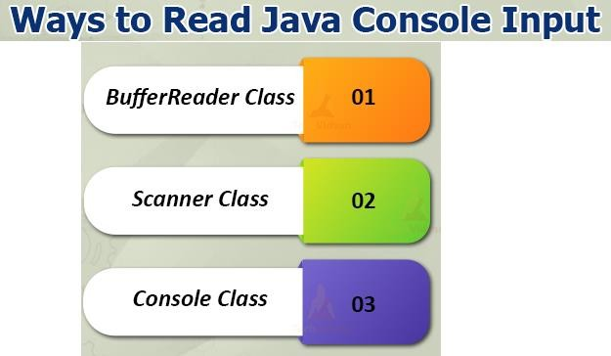

Slide 58
1.Using Buffered Reader Class
In Java, console input is accomplished by reading from System.in. To obtain a character based stream that is attached to the console, wrap System.in in a BufferedReader object.
BufferedReader supports a buffered input stream. Its most commonly used constructor is shown here:
BufferedReader(Reader inputReader)

Slide 59
Here, inputReader is the stream that is linked to the instance of BufferedReader that is being created. Reader is an abstract class. One of its concrete subclasses is InputStreamReader, which converts bytes to characters.
To obtain an InputStreamReader object that is linked to System.in, use the following constructor.
InputStreamReader(InputStream inputStream)
Because System.in refers to an object of type InputStream, it can be used for inputStream. Putting it all together, the following line of code creates a BufferedReader that is connected to the keyboard:
BufferedReader br = new BufferedReader(new InputStreamReader(System.in));

Slide 60
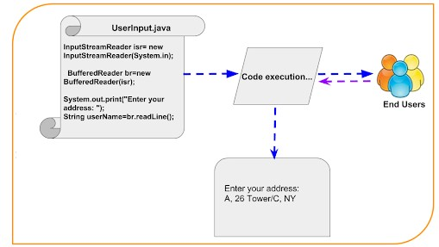

Slide 61
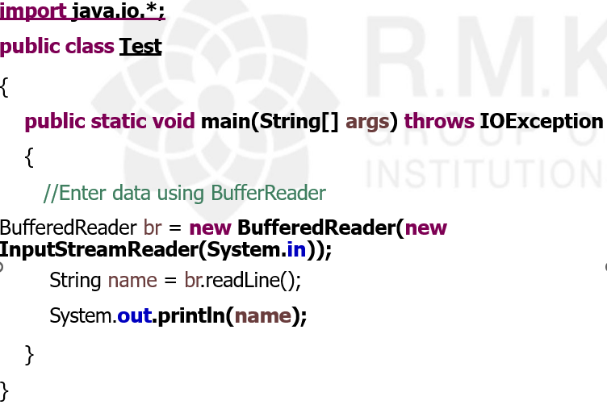
Input Computer Output Computer

Slide 62
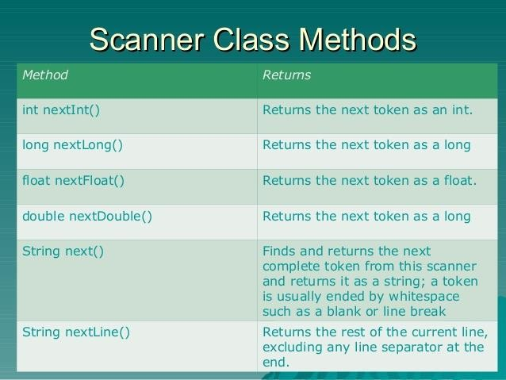
2. Using Scanner Class
This is probably the most preferred method to take input. The main purpose of the Scanner class is to parse primitive types and strings using regular expressions, however it is also can be used to read input from the user in the command line.

Slide 63
Advantages:
Convenient methods for parsing primitives (nextInt(), nextFloat(), …) from
the tokenized input.
Regular expressions can be used to find tokens.
Example
// Java program to demonstrate working of Scanner in Java
import java.util.Scanner;
class GetInputFromUser
{
public static void main(String args[])
{
// Using Scanner for Getting Input from User
Scanner in = new Scanner(System.in);
String s = in.nextLine();

Slide 64
System.out.println("You entered string: "+s);
int a = in.nextInt();
System.out.println("You entered integer: "+a);
float b = in.nextFloat();
System.out.println("You entered float: "+b);
}
}
Input Computer 12 14.3
Output
You entered string: Computer
You entered integer: 12
You entered float: 14.3

Slide 65
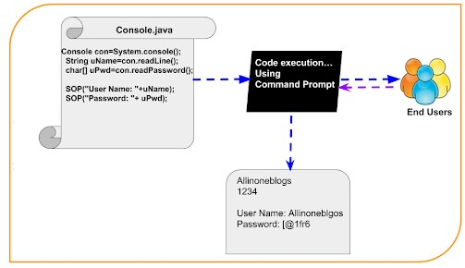
3. Using Console Class It is a preferred way for reading user’s input from the command line. In addition, it can be used for reading password-like input without choosing the characters entered by the user; the format string syntax can also be used (like System.out.printf()).

Slide 66
Reading password without choosing the entered characters.
Reading methods are synchronized.
Format string syntax can be used.
Drawback:
Does not work in non-interactive environment (such as in an IDE).
Example
public class Sample
{
public static void main(String[] args)
{
// Using Console to input data from user
String name = System.console().readLine();
System.out.println(name);
}
}

Slide 67
Writing Console Output
Console output is most easily accomplished with print() and println() methods. These methods are defined by the class PrintStream which is the type of object referenced by System.in.
Even though System.out is a byte stream, using it for a simple program output is still acceptable.
Because the PrintStream is an output stream derived from the OutputStream, it also implements the low-level method write(). Thus, write() can be used to write to the console.
The simplest form of write() defined by the PrintStream is shown below :
void write(int byteval)
This method writes the byte specified by byteval. Although byteval is declared as an integer, only the low-order eight bits are written.

Slide 68
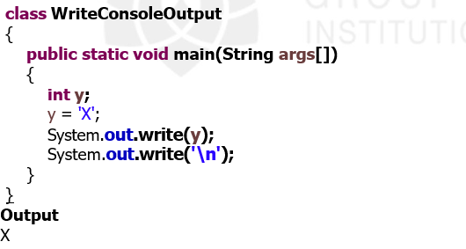
Example
You will not often use write() to perform console output (although doing so might be useful in some situations) because print() and println() are substantially easier to use.

Slide 69
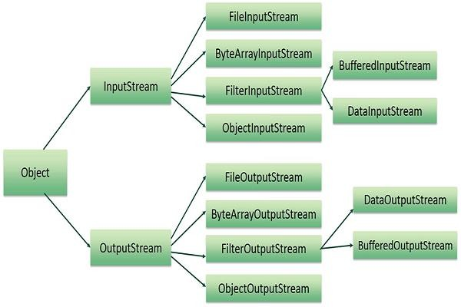
Reading and Writing Files
A stream can be defined as a sequence of data. The InputStream is used to read data from a source and the OutputStream is used for writing data to a destination.
Here is a hierarchy of classes to deal with Input and Output streams.

Slide 70
FileInputStream
This stream is used for reading data from the files. Objects can be created using the keyword new and there are several types of constructors available.
Following constructor takes a file name as a string to create an input stream object to read the file.
InputStream f = new FileInputStream("C:/java/hello");
Following constructor takes a file object to create an input stream object to read the file. First we create a file object using File() method as follows
File f = new File("C:/java/hello");
InputStream f = new FileInputStream(f);
Once you have InputStream object in hand, then there is a list of helper methods which can be used to read to stream or to do other operations on the stream.

Slide 71
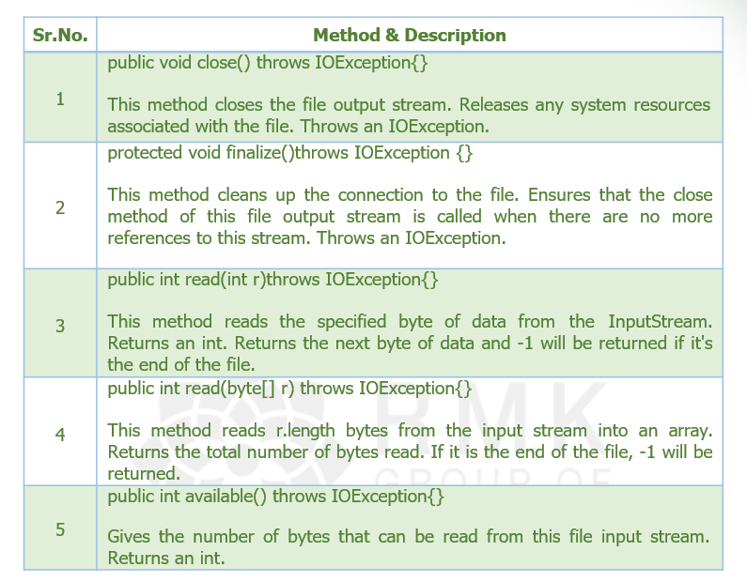

Slide 72
FileInputStream
There are other important input streams available, for more detail you can refer to the following links
ByteArrayInputStream
DataInputStream

Slide 73
FileOutputStream
FileOutputStream is used to create a file and write data into it. The stream would create a file, if it doesn't already exist, before opening it for output.
Here are two constructors which can be used to create a FileOutputStream object. Following constructor takes a file name as a string to create an input stream object to write the file
OutputStream f = new FileOutputStream("C:/java/hello");
Following constructor takes a file object to create an output stream object to write the file. First, we create a file object using File() method as follows
File f = new File("C:/java/hello");
OutputStream f = new FileOutputStream(f);
Once you have OutputStream object in hand, then there is a list of helper methods, which can be used to write to stream or to do other operations on the stream.

Slide 74
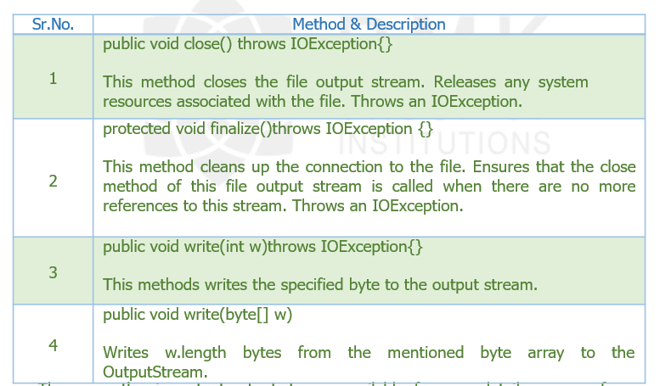

Slide 75
FileOutputStream
There are other important output streams available, for more detail you can refer
to the following links
ByteArrayOutputStream
DataOutputStream

Slide 76
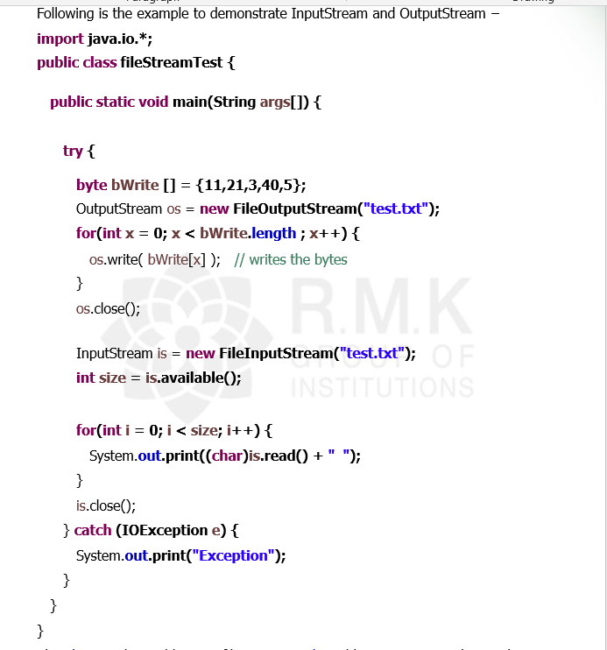
Example
The above code would create file test.txt and would write given numbers in binary format. Same would be the output on the stdout screen.

Slide 77
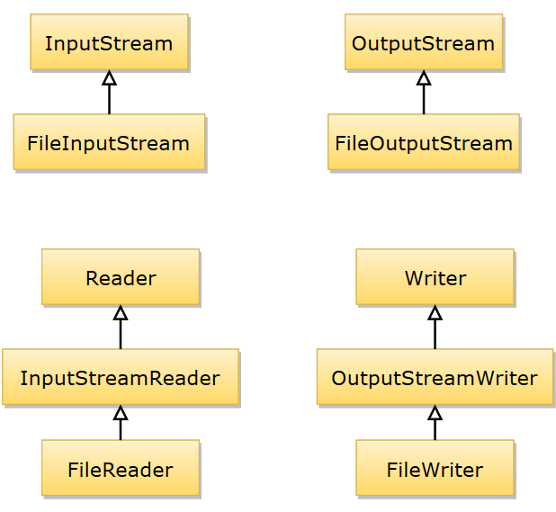
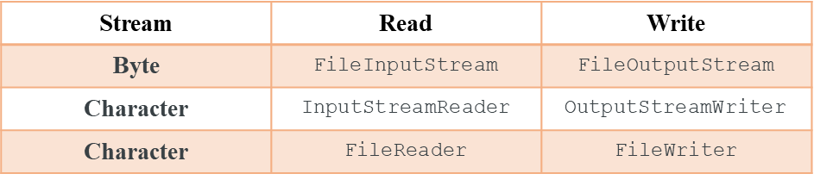
class diagrams that connects classes described above with abstract classes like Reader and Writer:

Slide 78
Generic Programming

Slide 79
Generic programming enables the programmer to create classes, interfaces and methods that automatically works with all types of data(Integer, String, Float etc).
It has expanded the ability to reuse the code safely and easily.
Advantages:
There are 3 main advantages of Java generics.
Type-safety: We can hold only a single type of objects in generics. It doesn’t allow to store other objects.
Type casting is not required: There is no need to typecast the object.
Compile-Time Checking: It is checked at compile time. so problem will not occur at runtime.

Slide 80
Generic class
A generic class is a class with one or more type variables.
Generics means parameterized types.
Parameterized types enables to create classes, interfaces and methods in which the type of data upon which they operate is specified as a parameter.
Class, interface, or method that operates on a parameterized type is called generic, as in generic class or generic method.
Syntax for declaring a generic class:
class class-name<type-param-list >
{ // …
Syntax for declaring a reference to a generic class:
class-name<type-arg-list > var-name =new class-name<type-arg-list >(cons-arg- list);
}

Slide 81
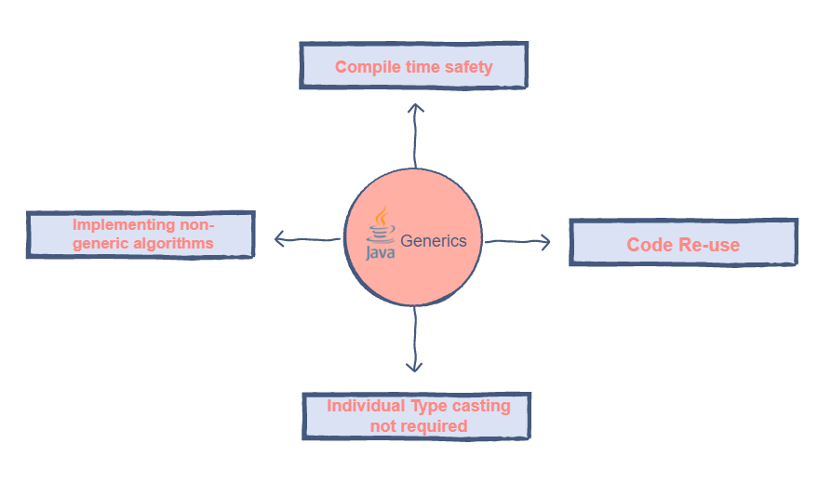

Slide 82
// A simple generic class. // Here, T is a type parameter
class Gen<T>
{
T ob; // declare an object of type
Gen(T o)
{
ob = o;
}// Return ob.
T getob()
{
return ob;
}// Show type of T.
void showType()
{
System.out.println("Type of T is " +ob.getClass().getName());
}}
public class GenDemo
{
public static void main(String[] args)
{
// Create a Gen reference for Integers.
Gen<Integer> iOb= new Gen<Integer>(88); iOb.showType();
int v = iOb.getob(); System.out.println("value: " + v);
// Create a Gen object for Strings.
Gen<String> strOb = new Gen<String> ("RMDEC"); strOb.showType();
String str = strOb.getob(); System.out.println("value: " + str);
}
}
Output:
Type of T is java.lang.Integer value: 88
Type of T is java.lang.String value: RMDEC

Slide 83
A Generic Class with Two Type Parameters
It is possible to declare more than one type parameter in a generic type. To specify two or more type parameters, simply use a comma-separated list.
class TwoGen<T, V>
{
T ob1; V ob2;
TwoGen(T o1, V o2)
{
ob1 = o1; ob2 = o2;
}
void showTypes()
{
System.out.println("Type of T is “ +ob1.getClass().getName());
System.out.println("Type of V is " +ob2.getClass().getName());
}

Slide 84
T getob1()
{
return ob1;
}
V getob2()
{
return ob2;
}
}
public class GenDemo
{
public static void main(String[] args)
{
// Create a Gen reference for Integers.
TwoGen<Integer, String> tgObj =new TwoGen<Integer, String>(88, " R.M.D Engineering College");
tgObj.showTypes();
int v = tgObj.getob1();
System.out.println("value: " + v);
String str = tgObj.getob2();
System.out.println("value: " + str);
}
}

Slide 85
Output:
Type of T is java.lang.Integer value: 88
Type of V is java.lang.String value: R.M.D Engineering College
Explanation:
Here, class TwoGen<T, V> has two type parameters: T and V, separated by a comma. Because it has two type parameters, two type arguments must be passed to TwoGen when an object is created. In this case, Integer is substituted for T, and String is substituted for V.

Slide 86
Generic methods
Methods inside a generic class can make use of a class type parameter and therefore, automatically generic relative to the type parameter.
However, it is possible to declare a generic method that uses one or more type parameters of its own.
The scope of arguments is limited to the method where it is declared. It allows static as well as non-static methods.
Syntax for a generic method:
<type-parameter> return_type method_name (parameters)
{
..........................
}

Slide 87
class Demo
{
static <V, T> void display (V v, T t)
{
System.out.println(v.getClass().getName()+" = " +v);
System.out.println(t.getClass().getName()+" = " +t);
}
public static void main(String[] args)
{
display(88," R.M.D Engineering College ");
}
}
Output:
java lang.Integer = 88
java lang.String = R.M.D Engineering College

Slide 88
Example 2
Following example illustrates how we can print an array of different type using a single Generic method
public class GenericMethodTest
{
// generic method printArray
public static < E > void printArray( E[] inputArray )
{
// Display array elements
for(E element : inputArray)
{
System.out.printf("%s ", element);
}
System.out.println();
}

Slide 89
public static void main(String args[])
{
// Create arrays of Integer, Double and Character
Integer[] intArray = { 1, 2, 3, 4, 5 };
Double[] doubleArray = { 1.1, 2.2, 3.3, 4.4 };
Character[] charArray = { 'R', 'M', 'D', 'E', 'C' };
System.out.println("Array integerArray contains:");
printArray(intArray); // pass an Integer array
System.out.println("Array doubleArray contains:");
printArray(doubleArray); // pass a Double array
System.out.println("Array characterArray contains:");
printArray(charArray); // pass a Character array
}
}
Output
Array integerArray contains:
1 2 3 4 5
Array doubleArray contains:
1.1 2.2 3.3 4.4
Array characterArray contains:
R M D E C

Slide 90
Bounded Types
In Java Generics it is possible to set restriction on the type that will be allowed to pass to a type-parameter. This is done with the help of extends keyword when specifying the type parameter.
< T extends Number >
Here we have taken Number class, it can be any wrapper class name. This
specifies that T can be only be replaced by Number class data itself or any of its subclass.
Example:
Create a generic class that contains a method that returns the average of an array of numbers.

Slide 91
class Stats<T extends Number>
{
T[] nums; // array of Number or subclass
Stats(T[] o)
{
nums = o;
}
double average()
{
double sum = 0.0;
for(int i=0; i < nums.length; i++) sum += nums[i].doubleValue(); return sum / nums.length;
}
}

Slide 92
public class GenDemo
{
public static void main(String[] args)
{
Integer inums[] = { 1, 2, 3, 4, 5 };
Stats<Integer> iob = new Stats<Integer>(inums);
double v = iob.average();
System.out.println("iob average is " + v);
Double dnums[] = { 1.1, 2.2, 3.3, 4.4, 5.5 };
Stats<Double> dob = new Stats<Double>(dnums);
double w = dob.average();
System.out.println("dob average is " + w);
}
}

Slide 93
Generic Interface
Comparable interface is a great example of Generics in interfaces and it’s written as:
Package .
import java.util.*;
public interface Comparable<T>
{
public int compareTo(T o);
}
In similar way, we can create generic interfaces in java. We can also have multiple type parameters as in Map interface. Again we can provide parameterized value to a parameterized type also, for example new HashMap<String, List<String>>(); is valid.

Slide 94
Restrictions and Limitations
There are a few restrictions that you need to keep in mind when using generics.
They involve creating objects of a type parameter, static members, exceptions, and arrays.
Type Parameters Can’t Be Instantiated .
It is not possible to create an instance of a type parameter. For example, consider this class:
class Gen<T> { T ob; Gen() { ob = new T(); // Illegal!!! } }
Here, it is illegal to attempt to create an instance of T. The reason is since T does not exist at run time, how the compiler doesn’t know what type of object to create.

Slide 95
Restrictions on Static Members
No static member can use a type parameter declared by the enclosing class. For example, both of the static members of this class are illegal:
class Wrong<T>
{
// Wrong, no static variables of type T.
static T ob;
// Wrong, no static method can use T.
static T getob()
{
return ob;
}
}
Although we can’t declare static members that use a type parameter declared by the enclosing class, we can declare static generic methods, which define their own type parameters.

Slide 96
Generic Array Restrictions
There are two important generics restrictions that apply to arrays.
First, you cannot instantiate an array whose element type is a type parameter. Second, you cannot create an array of type-specific generic references. The following short program shows both situations:
// Generics and arrays.
class Gen<T extends Number>
{
T ob;
T vals[]; // OK Gen(T o, T[] nums)
{
ob = o;
// This statement is illegal.
// vals = new T[10]; // can't create an array of T
// But, this statement is OK.
vals = nums; // OK to assign reference to existent array

Slide 97
}
}
class GenArrays
{
public static void main(String args[])
{
Integer n[] = { 1, 2, 3, 4, 5 };
Gen<Integer> iOb = new Gen<Integer>(50, n);
// Can't create an array of type-specific generic references.
// Gen<Integer> gens[] = new Gen<Integer>[10]; // Wrong!
// This is OK.
Gen<?> gens[] = new Gen<?>[10]; // OK
}
}

Slide 98
The reason you can’t create an array of T is that T does not exist at run time, so there is no way for the compiler to know what type of array to actually create. However, you can pass a reference to a type-compatible array to Gen( ) when an object is created and assign that reference to vals, as the program does in this line:
Generic Exception Restriction
A generic class cannot extend Throwable. This means that you cannot create generic exception classes.
Runtime Type Inquiry Only Works with Raw Types
Objects in the virtual machine always have a specific nongeneric type. Therefore, all type inquiries yield only the raw type. you will get a compiler error (with instanceof) or warning (with casts) when you try to inquire whether an object belongs to a generic type.

Slide 99
Beware of Clashes after Erasure
It is illegal to create conditions that cause clashes when generic types are erased. Here is an example. Suppose we add an equals method to the Pair class,
public class Pair<T>
{
public boolean equals(T value)
{
return first.equals(value) && second.equals(value);
. . .
}
Consider a Pair<String>. Conceptually, it has two equals methods: boolean equals(String) // defined in Pair<T>
boolean equals(Object) // inherited from Object
But the intuition leads us astray. The erasure of the method boolean equals(T) is boolean equals(Object) which clashes with the Object.equals method. The remedy is, to rename the offending method.

Slide 100
THANK YOU

